Slide 1

SANJIVANI UNIVERSITY
SANJIVANI GROUP OF INSITUTIES
PRESENTAION ON:-
Digital forensics
Presentated By:
PARJANE SIDDHANT VILAS
GUIDED BY:PROF. CHAITANYA KALE
HOD: DR. K. VENGATENSAN

Slide 2
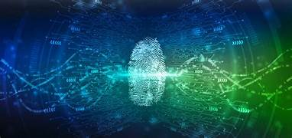
Content
Introduction
Literature Survey
Objective and scope
Real time Application
Advantages & Disadvantages
System Architecture
Methodology
Existing System
Conclusion
Reference

Slide 3
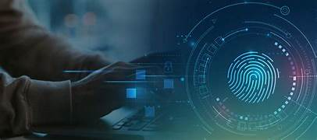
INTRODUCTION
Digital forensics is the process of recovering, preserving, and analyzing data from digital devices to investigate cybercrimes and other digital incidents. It involves the use of specialized techniques to collect evidence from computers, smartphones, networks, and other electronic devices, ensuring that the information is handled in a way that maintains its integrity and admissibility in legal contexts. Digital forensics plays a crucial role in law enforcement, corporate investigations, and cybersecurity, helping to uncover unauthorized access, data breaches, and various forms of digital misconduct.
In addition to investigating crimes, digital forensics is also essential for incident response and risk management in organizations, as it helps identify vulnerabilities, assess damage, and develop strategies to prevent future breaches.

Slide 4
ABSTRACT
Digital forensics is a specialized field focused on the identification, preservation, analysis, and presentation of digital evidence in legal and investigative contexts. It encompasses the recovery of data from computers, mobile devices, and networks, providing critical insights into cybercrimes and data breaches. This discipline not only aids law enforcement in criminal investigations but also supports organizations in managing cybersecurity incidents and enhancing their defenses. By employing rigorous methodologies, digital forensics ensures that evidence is collected and handled properly, maintaining its integrity for potential use in court.

Slide 5
Literature Survey
PAPER TITLE | AUTHOR | PUBLICATION | PUBLICATION DATE | FINDINGS
"A Survey of Digital Forensics: Approaches and Challenges" | A. A. A. M. Alahmadi, J. Alhazmi | International Journal of Computer Applications | 2015 | This survey discusses various methodologies in digital forensics, identifies key challenges in the field, and emphasizes the need for standardized practices and tools.

Slide 6
Literature Survey
PAPER TITLE | AUTHOR | PUBLICATION | PUBLICATION DATE | FINDINGS
"Digital Forensics: Principles and Practice" | Eoghan Casey | Morgan Kaufmann | 2011 | This book provides a comprehensive overview of digital forensics, including the principles, tools, and techniques essential for effective investigations. It highlights the integration of forensic practices with legal frameworks..

Slide 7
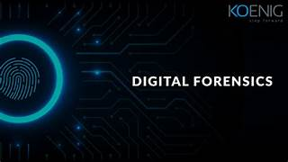
OBJECTIVES
Data Recovery: Retrieving lost or deleted data from digital devices.
Evidence Collection: Collecting digital evidence in a manner that maintains its integrity.
Analysis: Examining the data to uncover patterns, timelines, and user actions.
Incident Response: Assisting in the identification and mitigation of security breaches.
Legal Compliance: Ensuring that investigations adhere to legal standards and practices.
Reporting: Creating clear and comprehensive reports that can be used in legal proceedings.

Slide 8
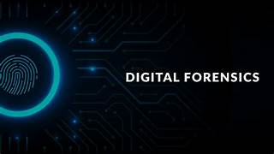
REAL TIME APPLICATION
Cybersecurity Incident Response: In the event of a cyberattack, digital forensics helps identify the breach's origin, assess damage, and prevent future incidents.
Fraud Detection: Organizations use digital forensics to analyze transactions and uncover fraudulent activities in real-time, especially in financial institutions.
Legal Investigations: Law enforcement agencies leverage digital forensics during active investigations to gather evidence from devices, networks, and cloud services.
Data Breach Analysis: After a data breach, companies conduct forensic investigations to understand the breach's scope and mitigate risks immediately.
Insider Threat Detection: Real-time monitoring of employee activities can help identify and mitigate potential insider threats before they escalate.

Slide 9
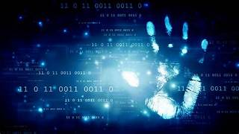
ADVANTAGES & DISADVANTAGES
Rapid Evidence Collection: Digital forensics allows for the swift collection and preservation of electronic evidence, which can be crucial in investigations.
Detailed Analysis: It enables in-depth analysis of digital devices, uncovering hidden data, deleted files, and user activity logs.
Global Reach: Digital evidence can often be collected from remote locations, making it easier to investigate crimes that span different jurisdictions.
Automation and Tools: Advanced software tools can automate various forensic processes, enhancing efficiency and accuracy.
Disadvantages
Complexity: The rapidly evolving nature of technology can make digital forensics complex and require continuous training and adaptation.
Cost: High-quality forensic tools and expert personnel can be expensive, posing a financial burden for some organizations.
Data Privacy Concerns: Investigations can raise ethical issues regarding privacy, especially when sensitive personal data is involved.

Slide 10
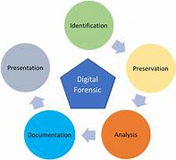
System architecture

Slide 11
METHEDOLOGIES OF ALGORITHAMS
Preparation
Develop policies and procedures.
Train investigators.
Identification
Identify relevant evidence sources.
Document details about evidence.
Collection
Preserve evidence by creating forensic images.
Maintain a chain of custody.
Examination
Recover data and analyze file systems.
Examine metadata and logs.
Presentation
Prepare a detailed report.
Provide expert testimony if needed.
Review and Feedback
Conduct a post-investigation review.
Implement continuous improvements

Slide 12
Existing system
Forensic Frameworks and Methodologies
ACPO Good Practice Guide: Provides guidelines for digital evidence collection, focusing on maintaining the integrity of data.
ISO/IEC 27037: Standards for identifying, collecting, and analyzing digital evidence.
NIST Guidelines: National Institute of Standards and Technology guidelines on digital forensics best practices.

Slide 13
Conclusion
In conclusion, digital forensics systems play a vital role in enhancing security, ensuring justice, and protecting individual rights in our increasingly digital world. By providing reliable methods for collecting and analyzing digital evidence, these systems help law enforcement solve crimes, assist organizations in mitigating cyber threats, and uphold legal standards.
Ultimately, the effectiveness and integrity of digital forensics contribute to a safer environment, fostering trust in digital interactions. This assurance helps individuals feel more secure, knowing that their rights and data are protected, leading to greater confidence in technology and its applications. In this way, Digital forensics systems significantly contribute to overall societal well-being and happiness.

Slide 14
THANKYOU.....

